Slide 1

Mathematics for Computer Science

Slide 2
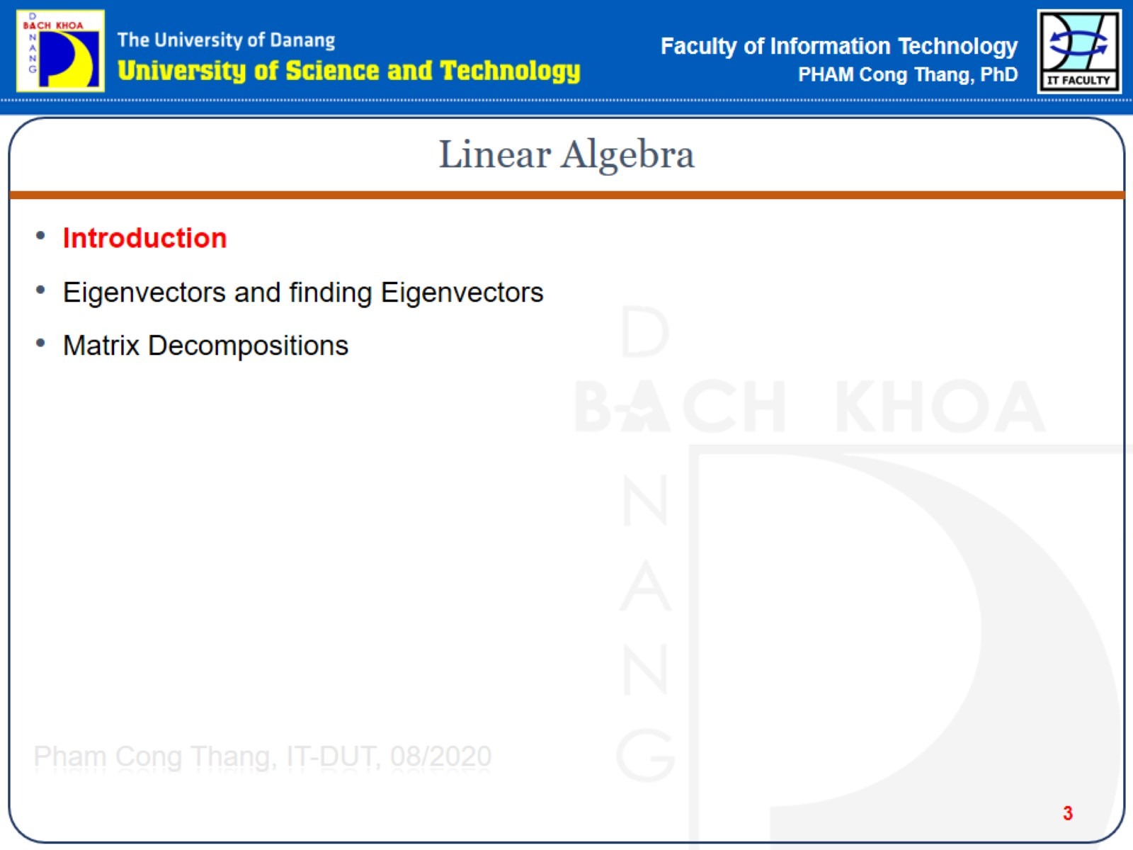
Linear Algebra

Slide 3
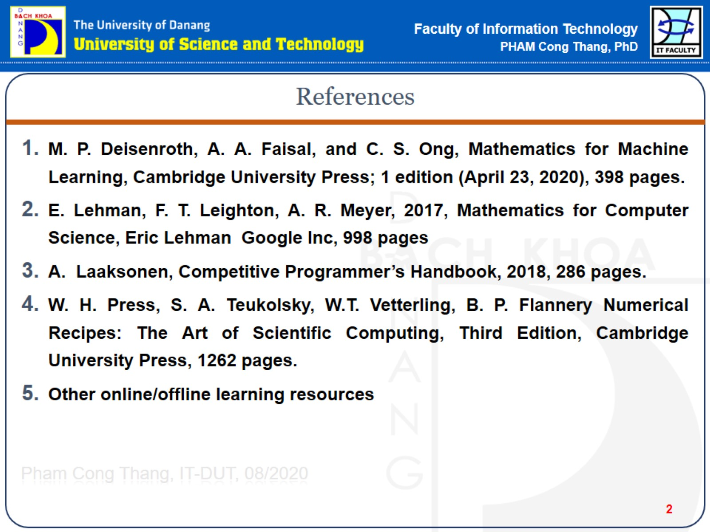
References

Slide 4
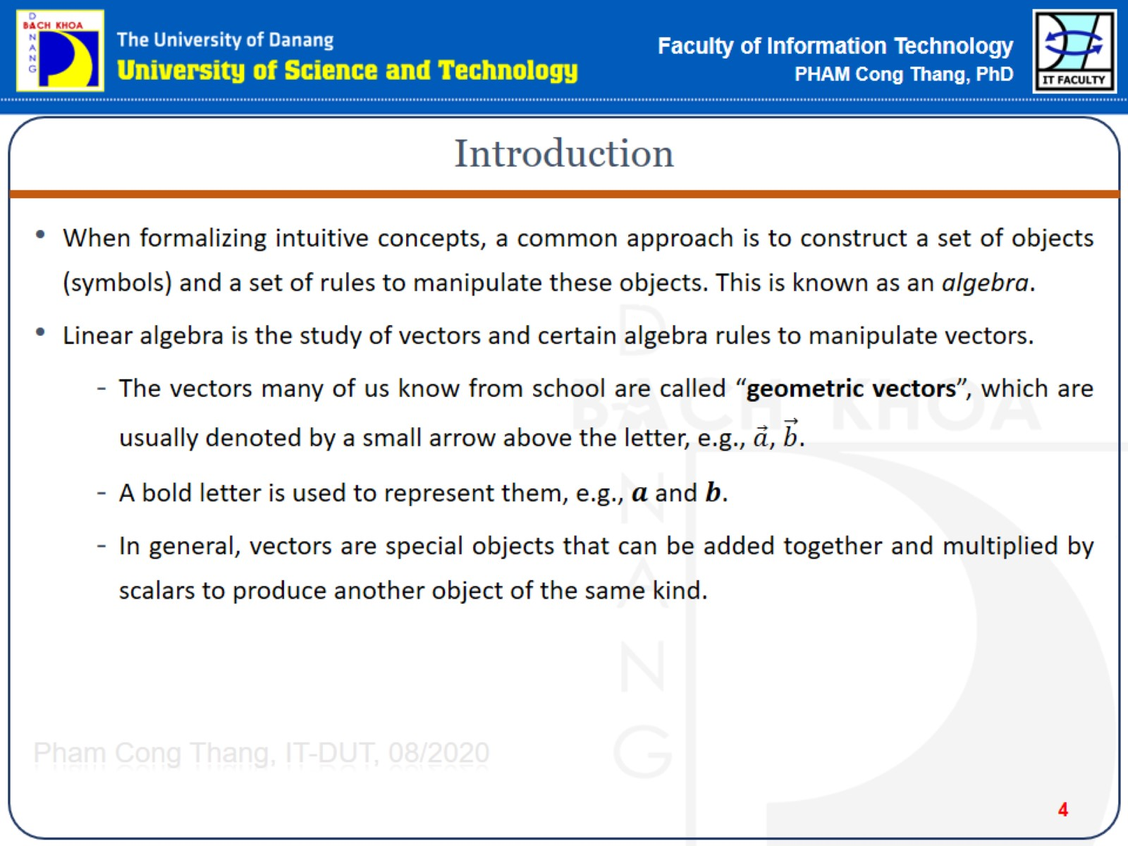
Introduction
Notes:
chữ cái in đậm -> vector
thường -> chữ số

Slide 5
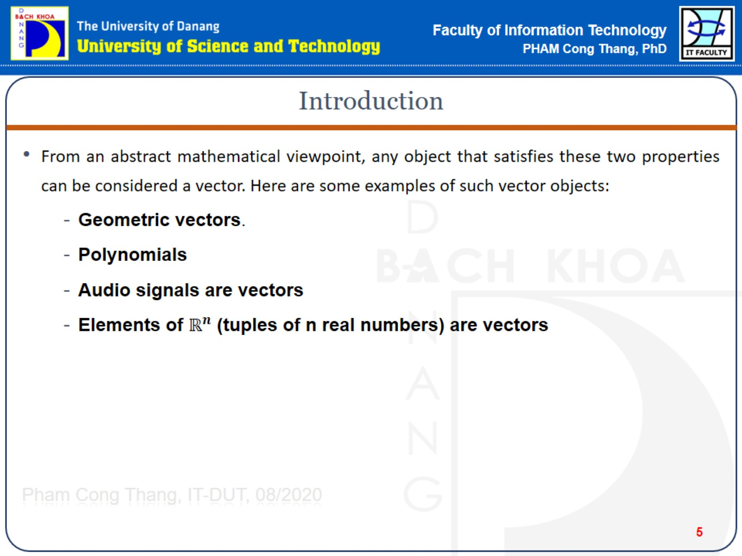
Introduction

Slide 6
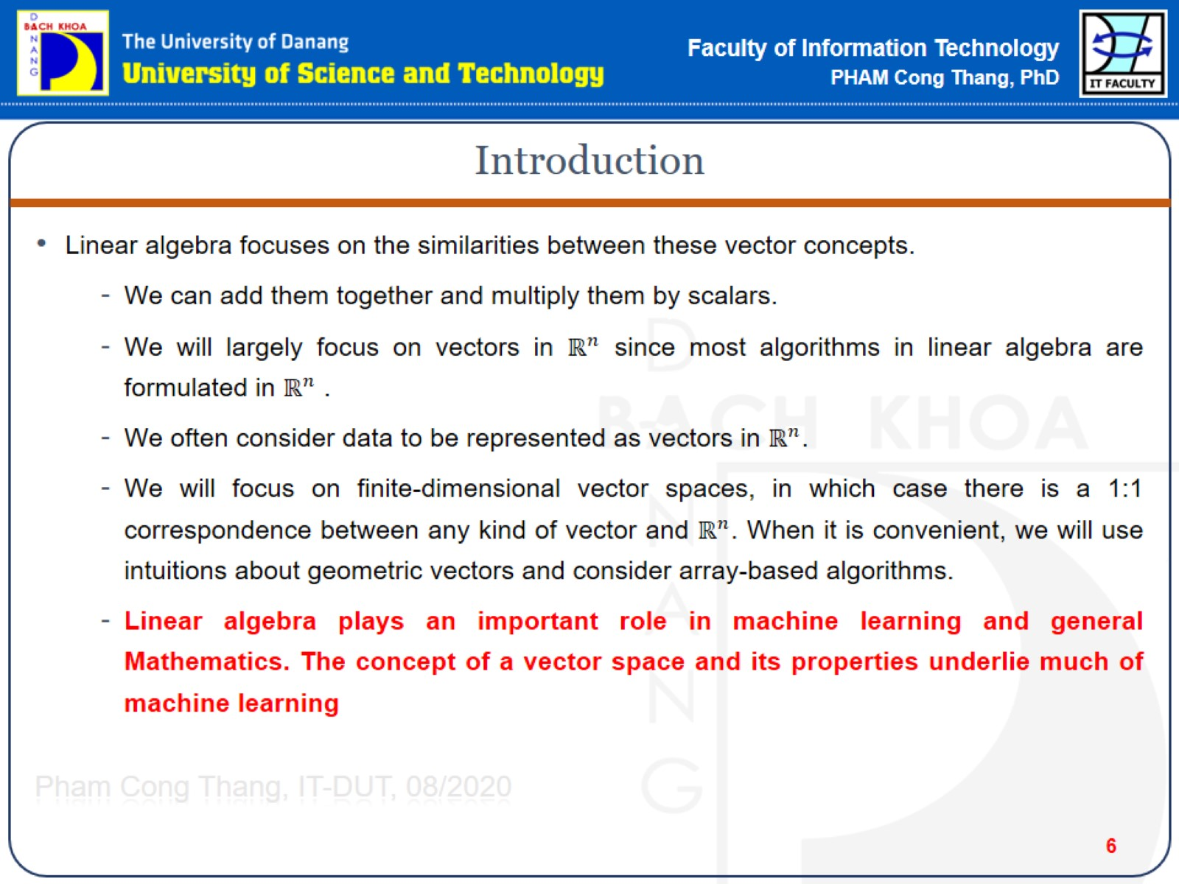
Introduction

Slide 7
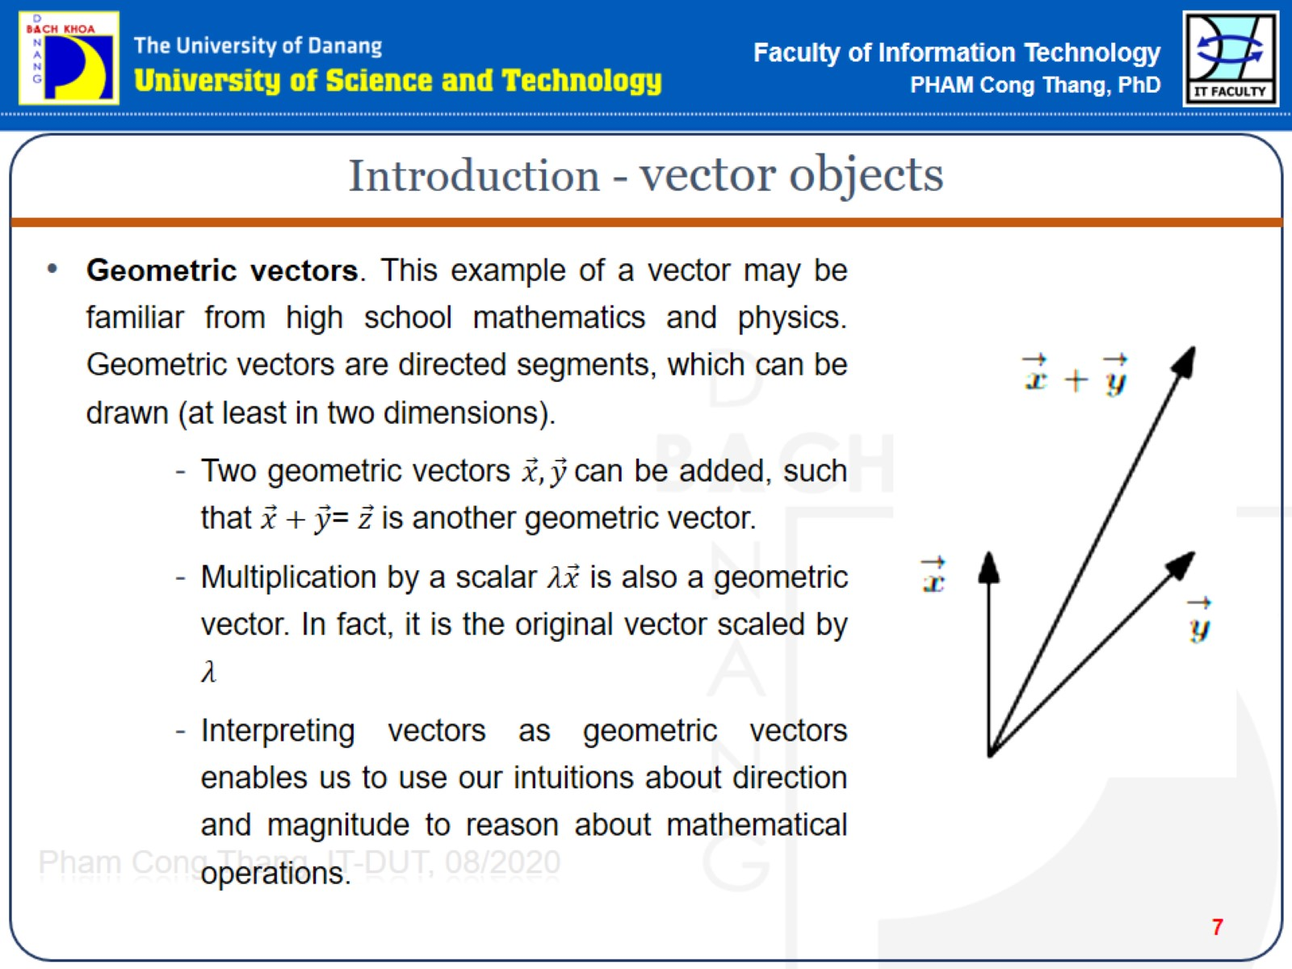
Introduction - vector objects

Slide 8
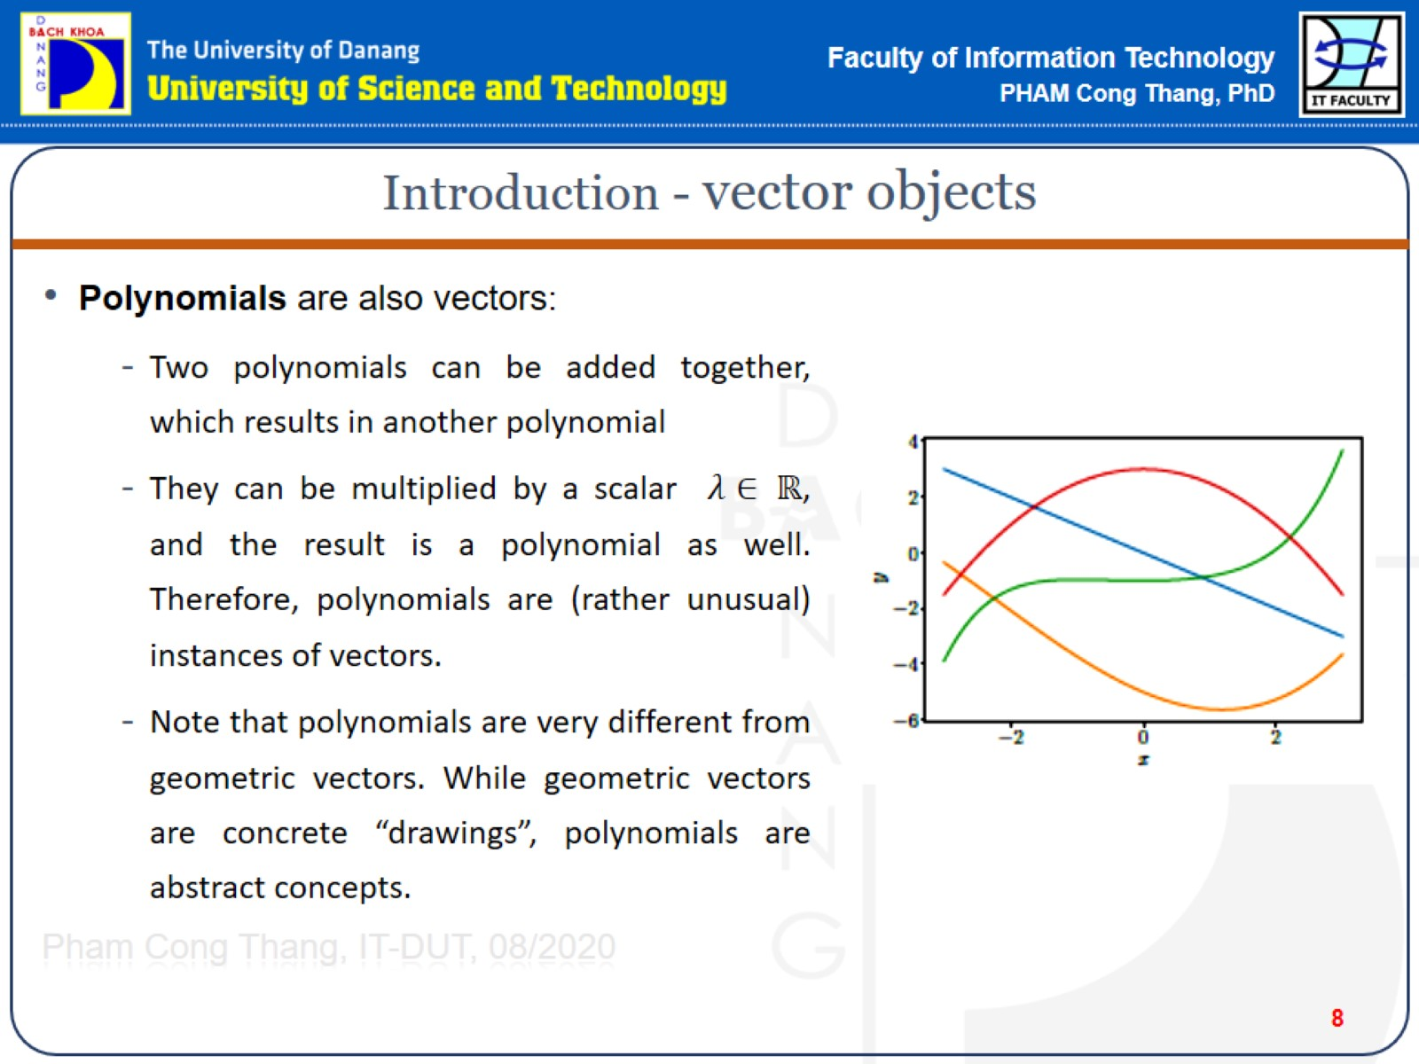
Introduction - vector objects

Slide 9
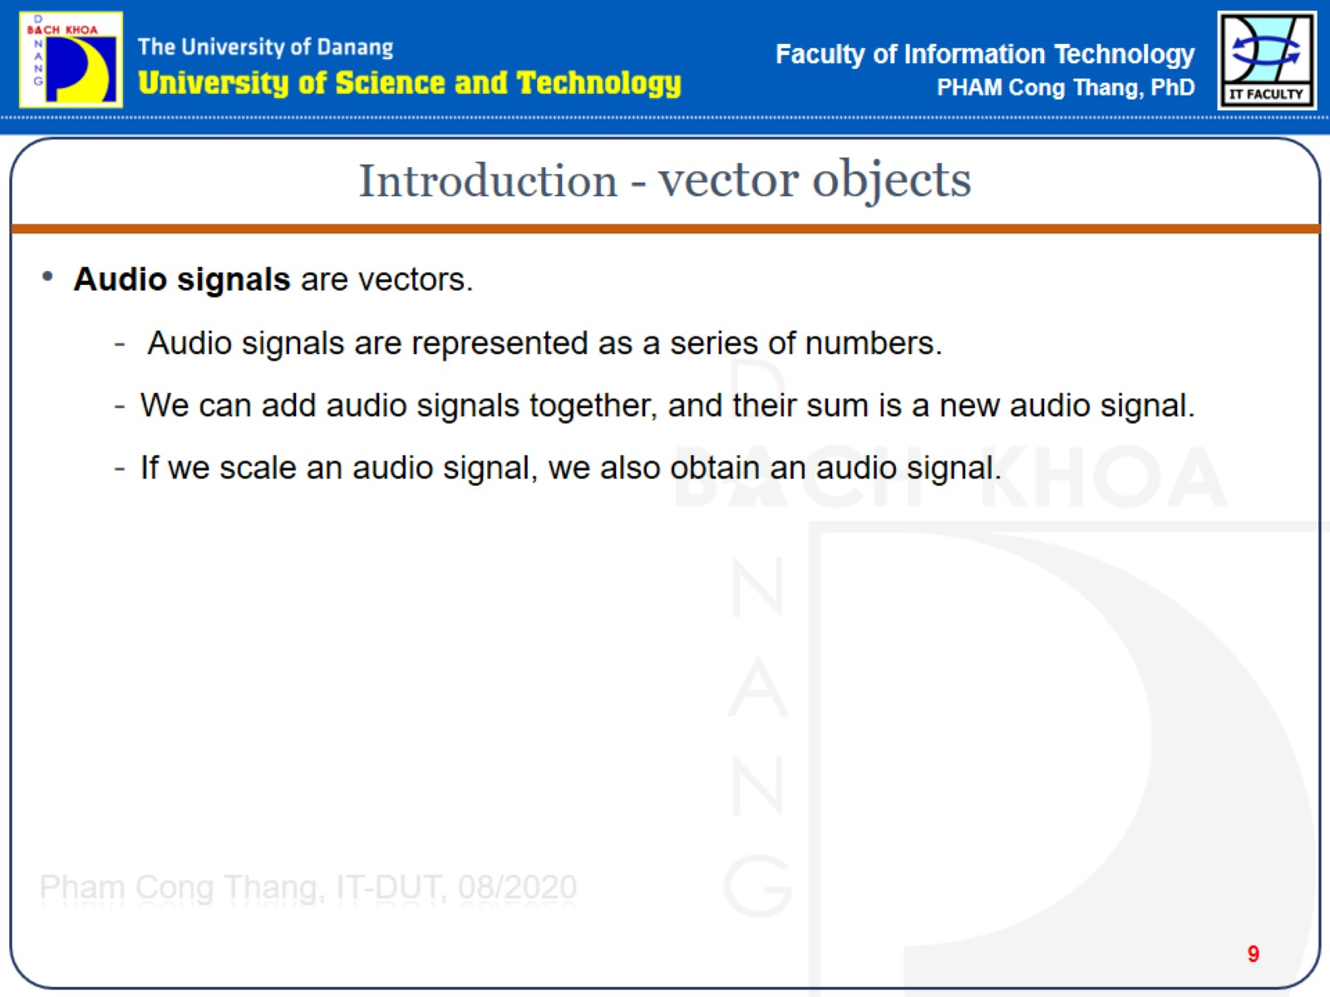
Introduction - vector objects

Slide 10
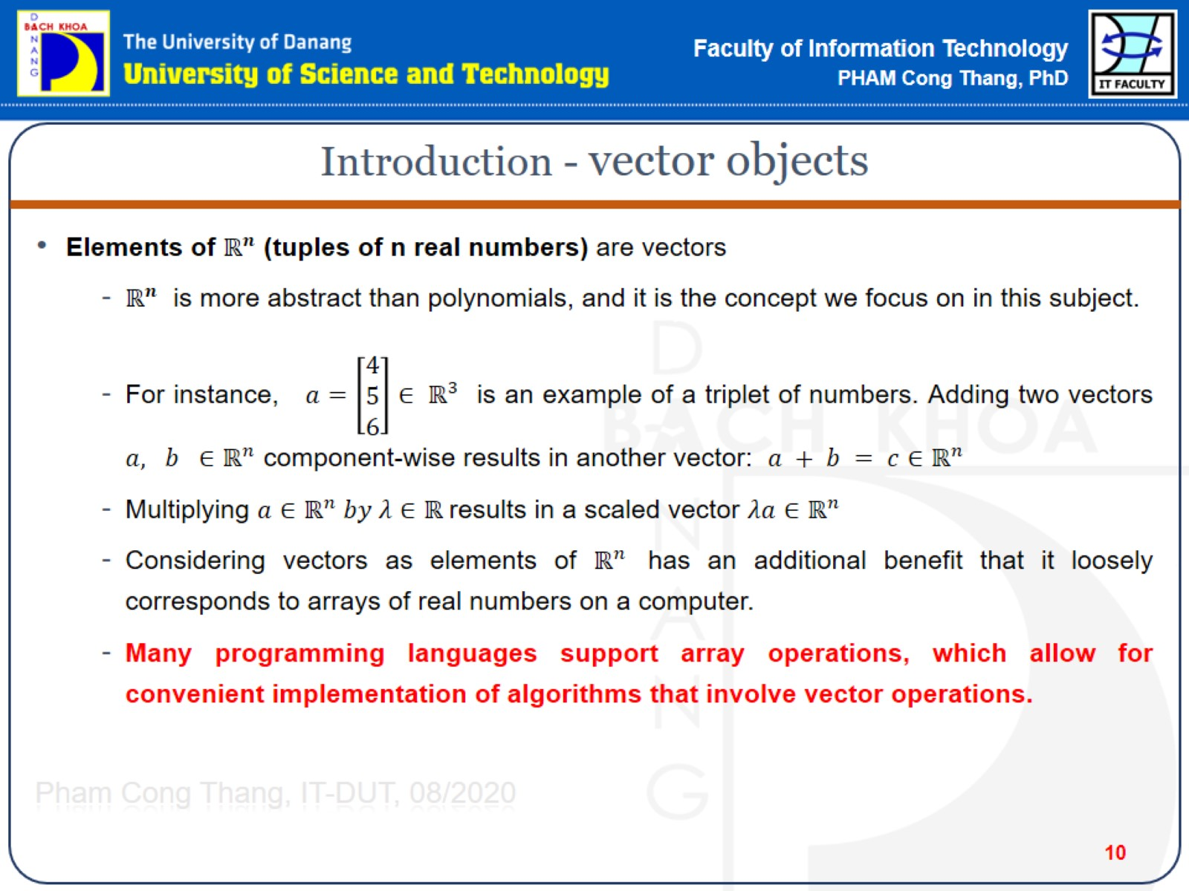
Introduction - vector objects

Slide 11
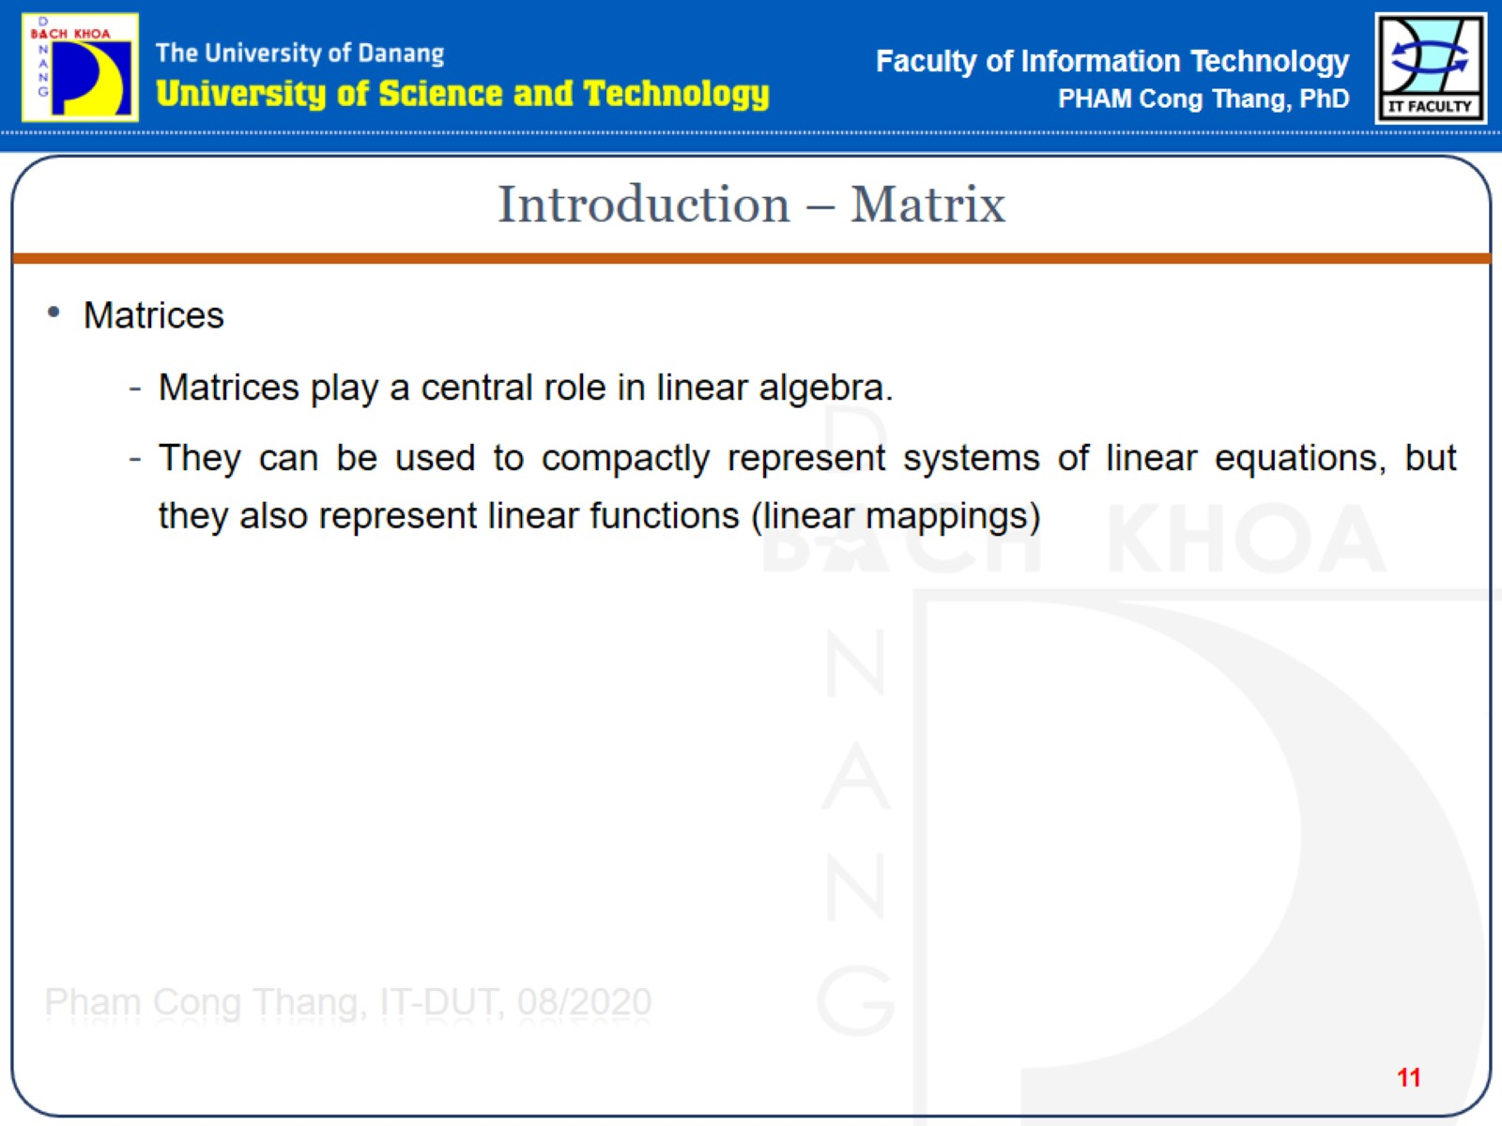
Introduction – Matrix

Slide 12
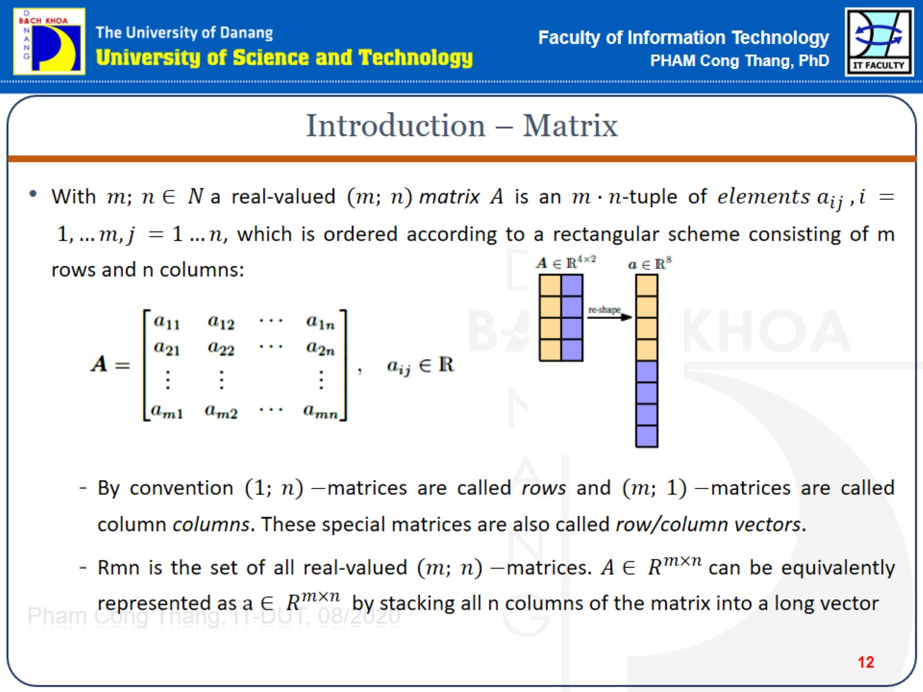
Introduction – Matrix

Slide 13
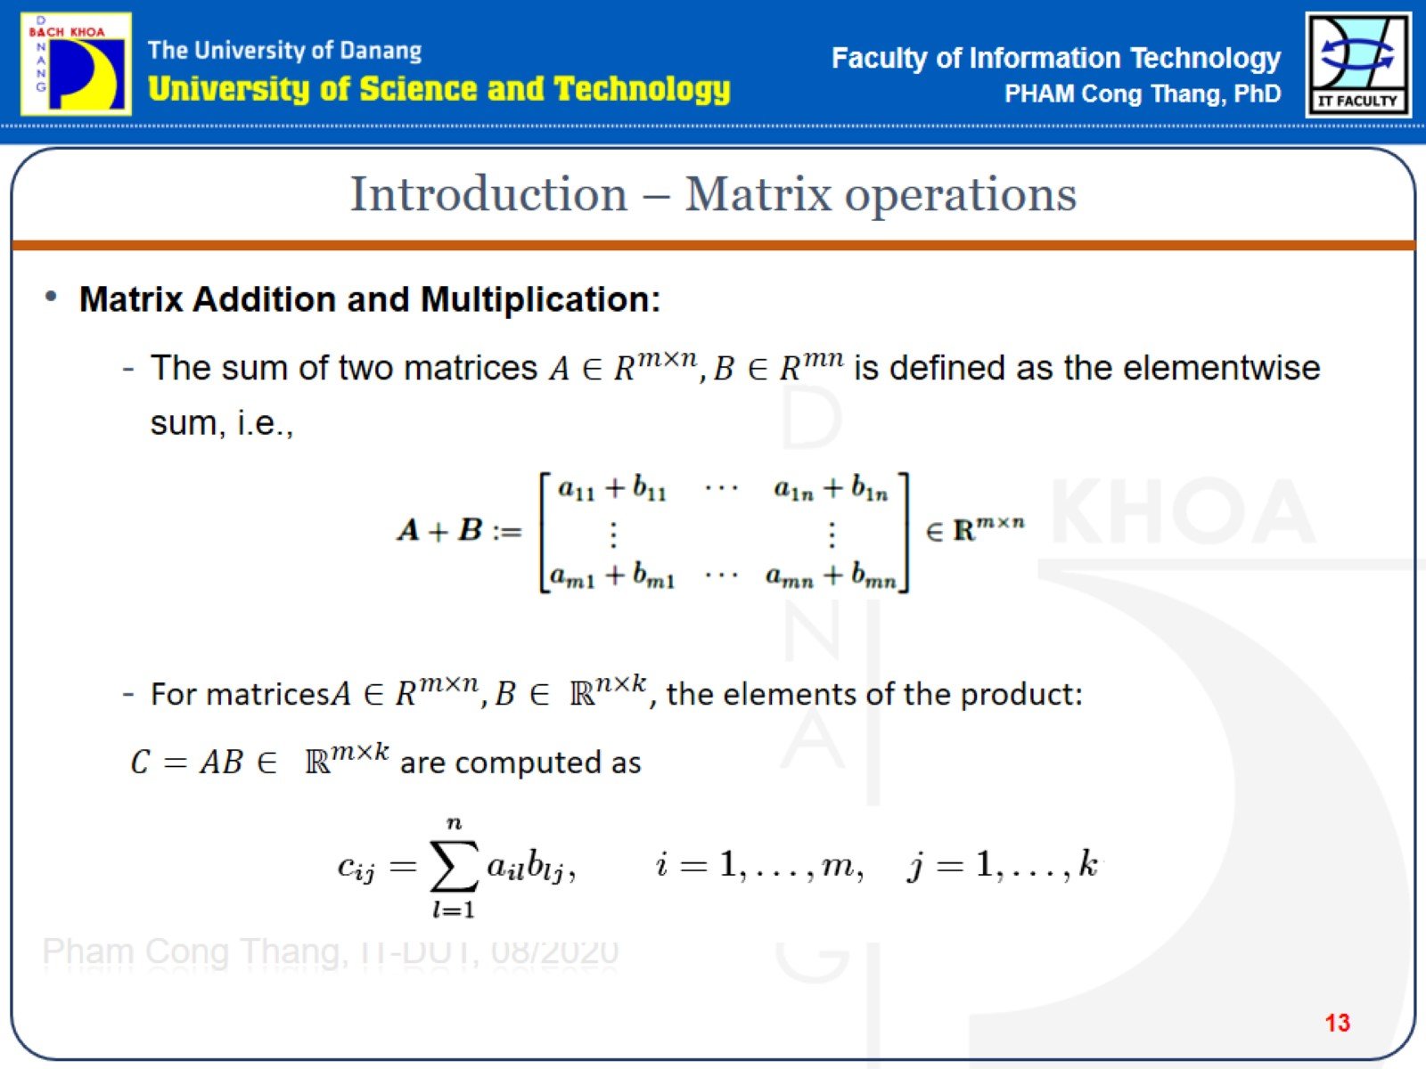
Introduction – Matrix operations

Slide 14
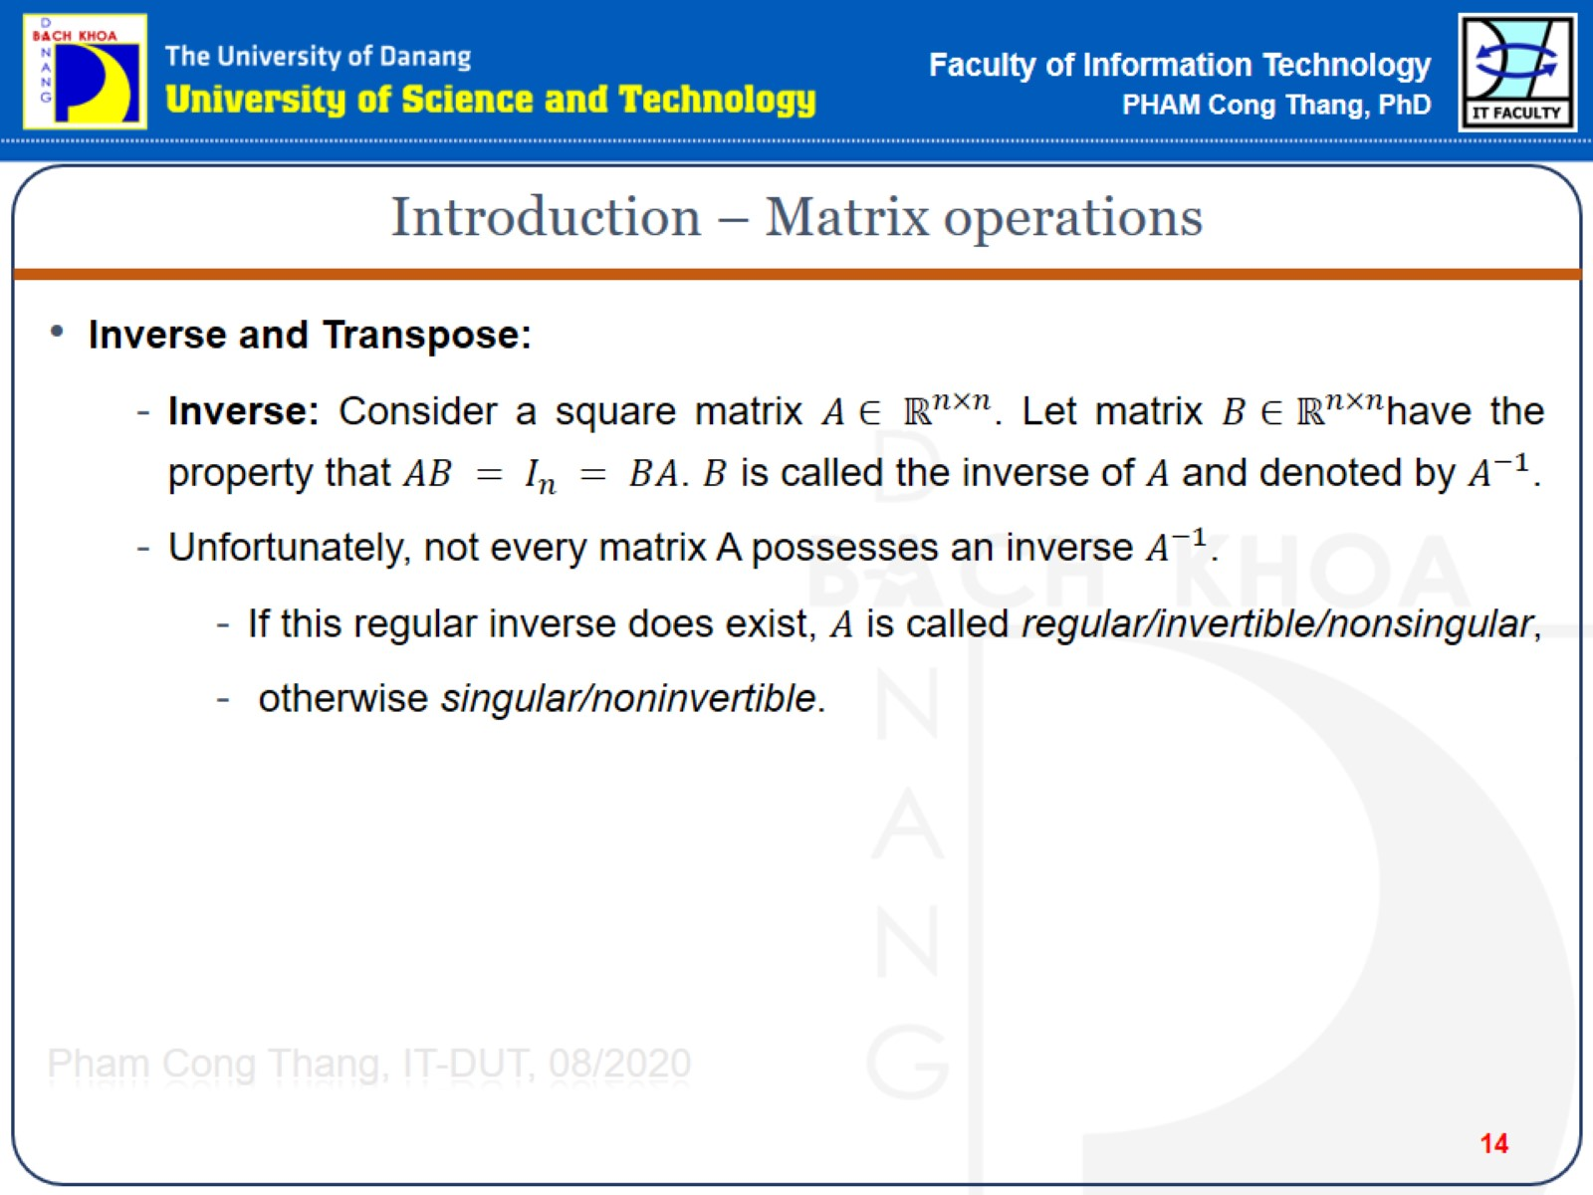
Introduction – Matrix operations

Slide 15
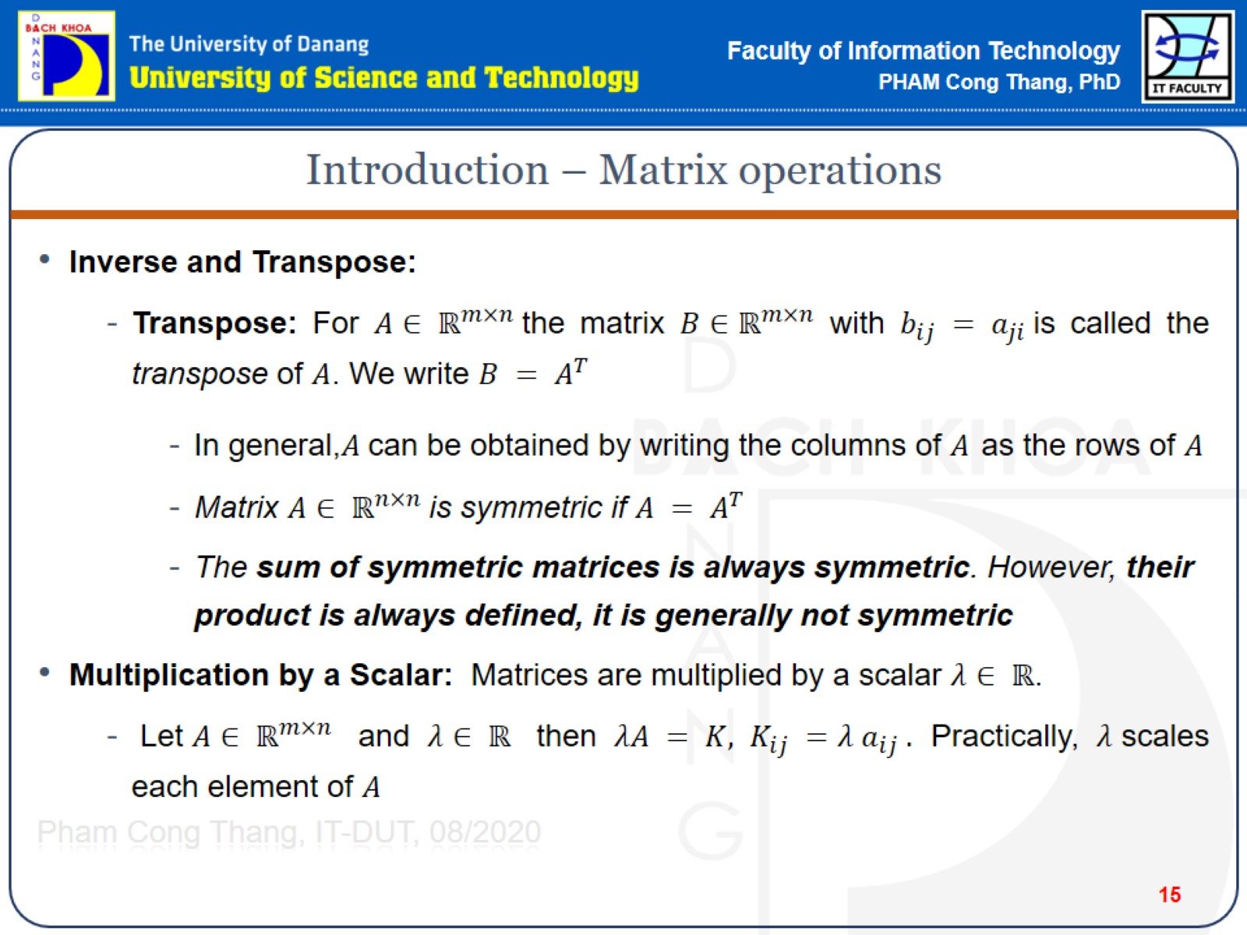
Introduction – Matrix operations

Slide 16
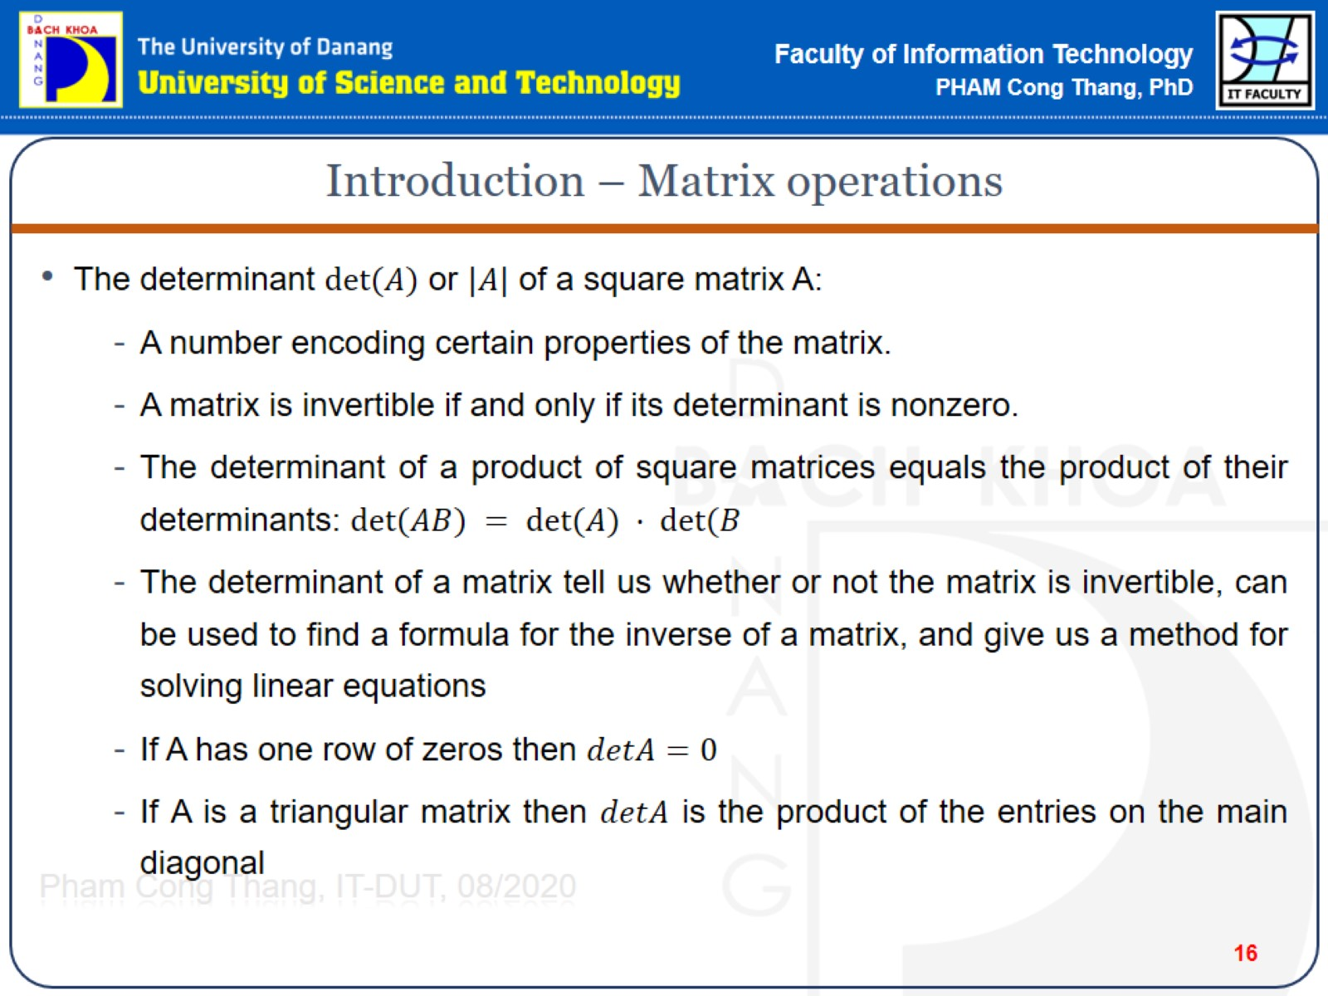
Introduction – Matrix operations

Slide 17
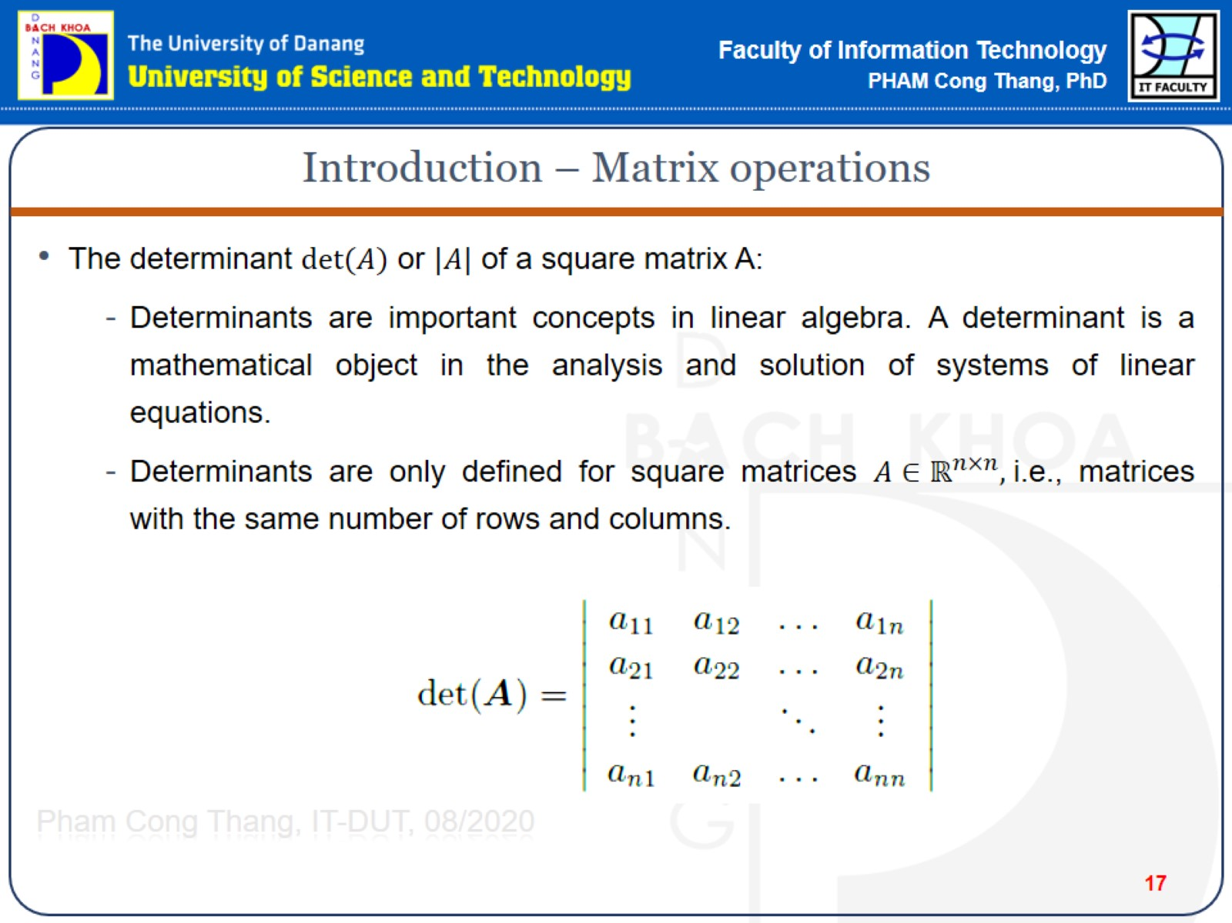
Introduction – Matrix operations

Slide 18
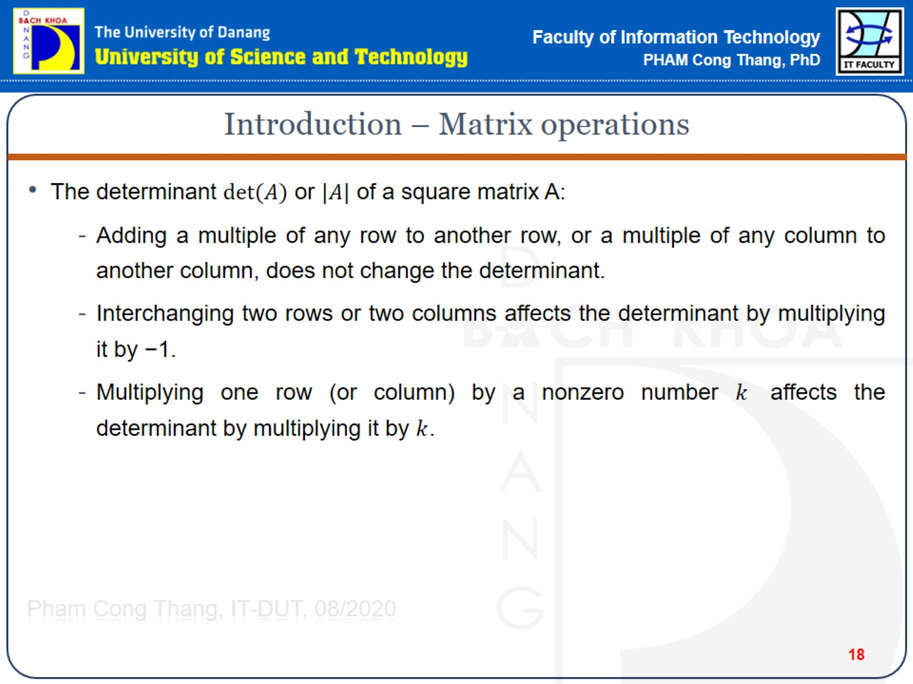
Introduction – Matrix operations

Slide 19
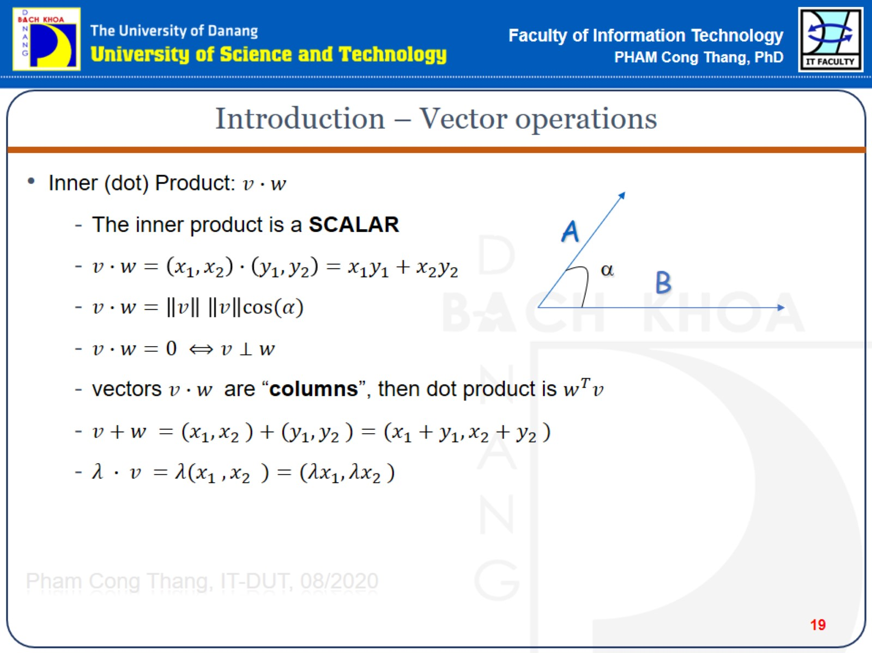
Introduction – Vector operations

Slide 20
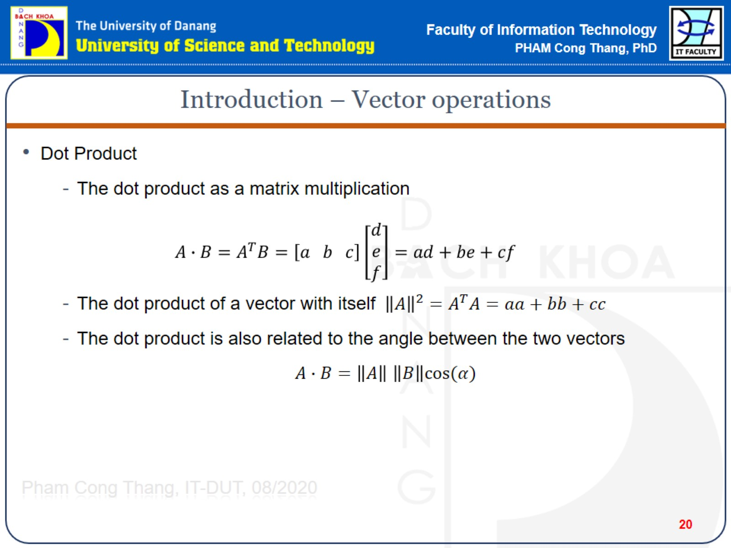
Introduction – Vector operations

Slide 21
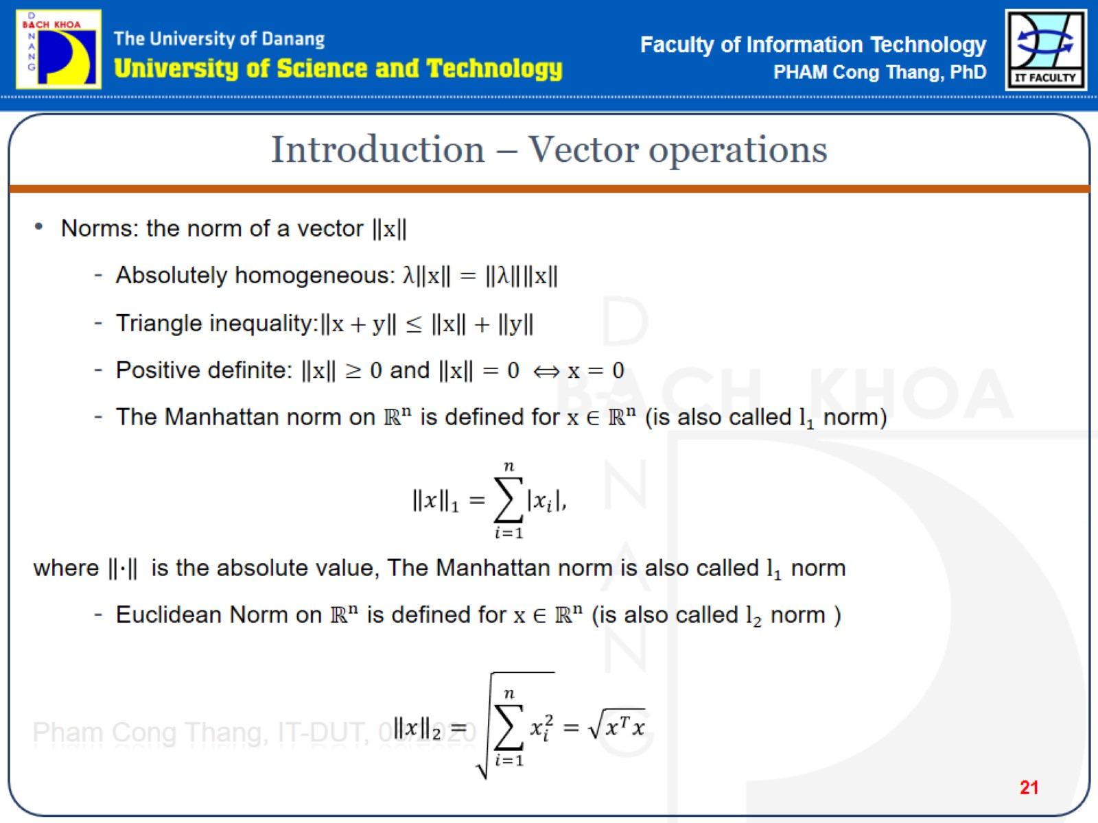
Introduction – Vector operations

Slide 22
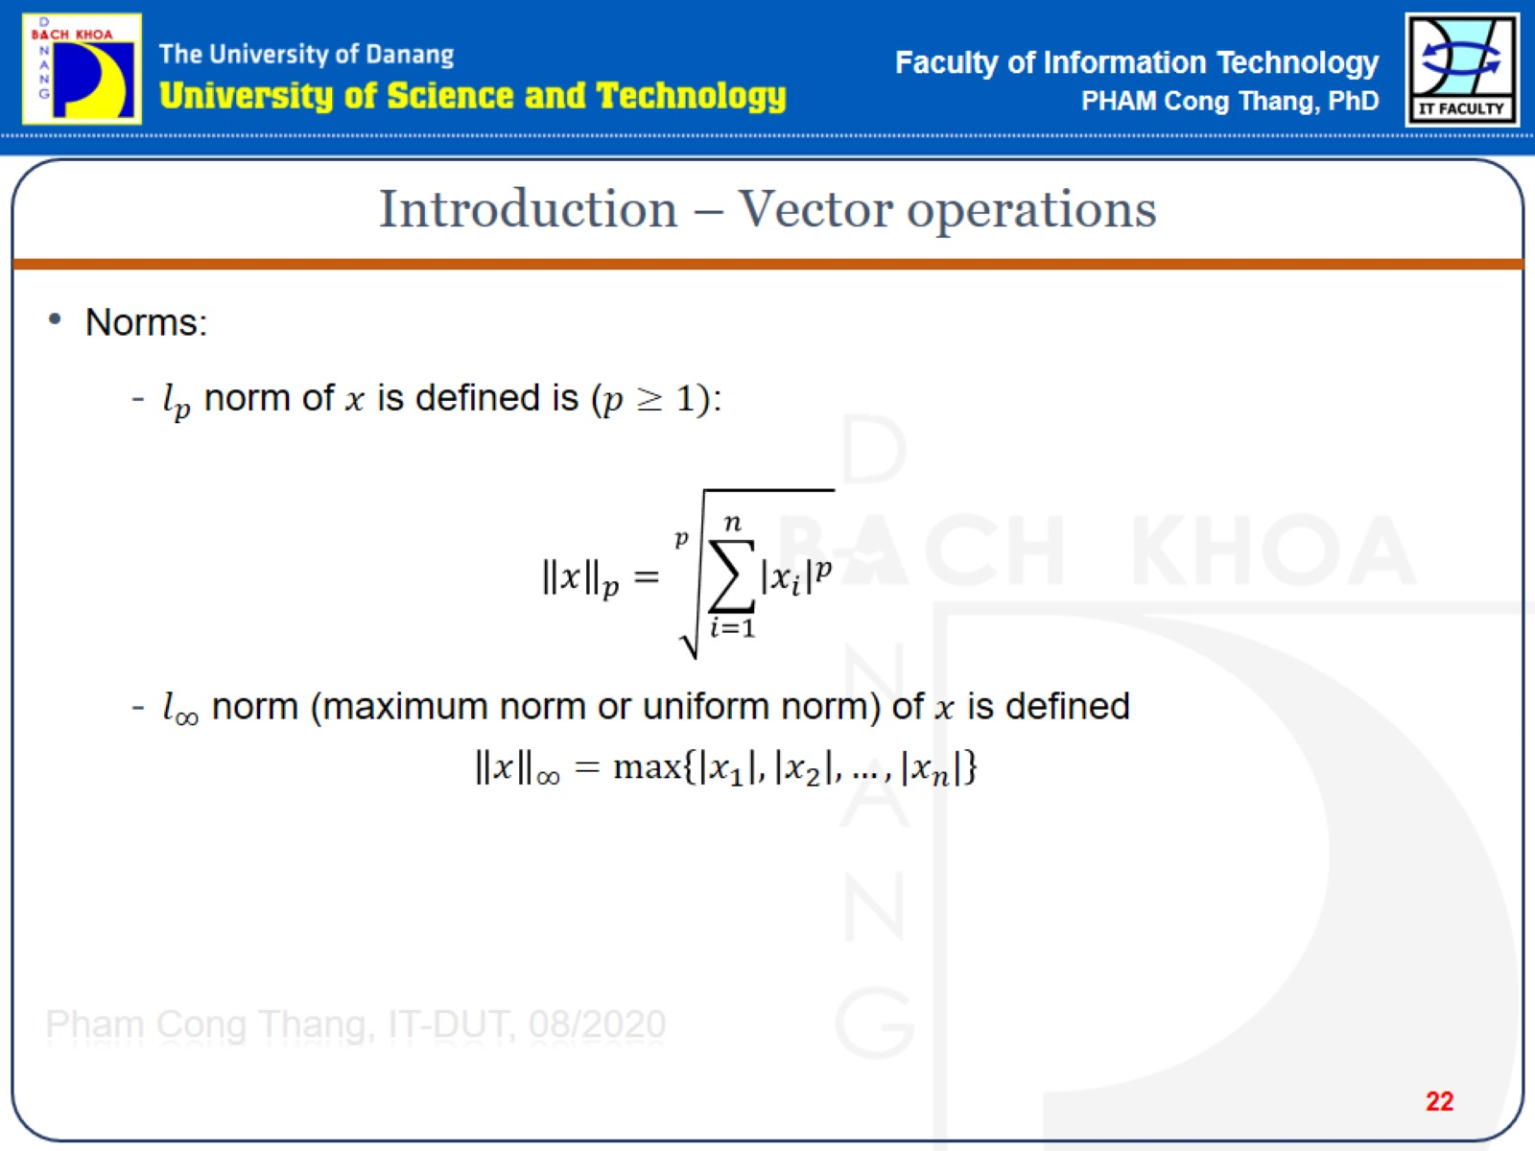
Introduction – Vector operations

Slide 23
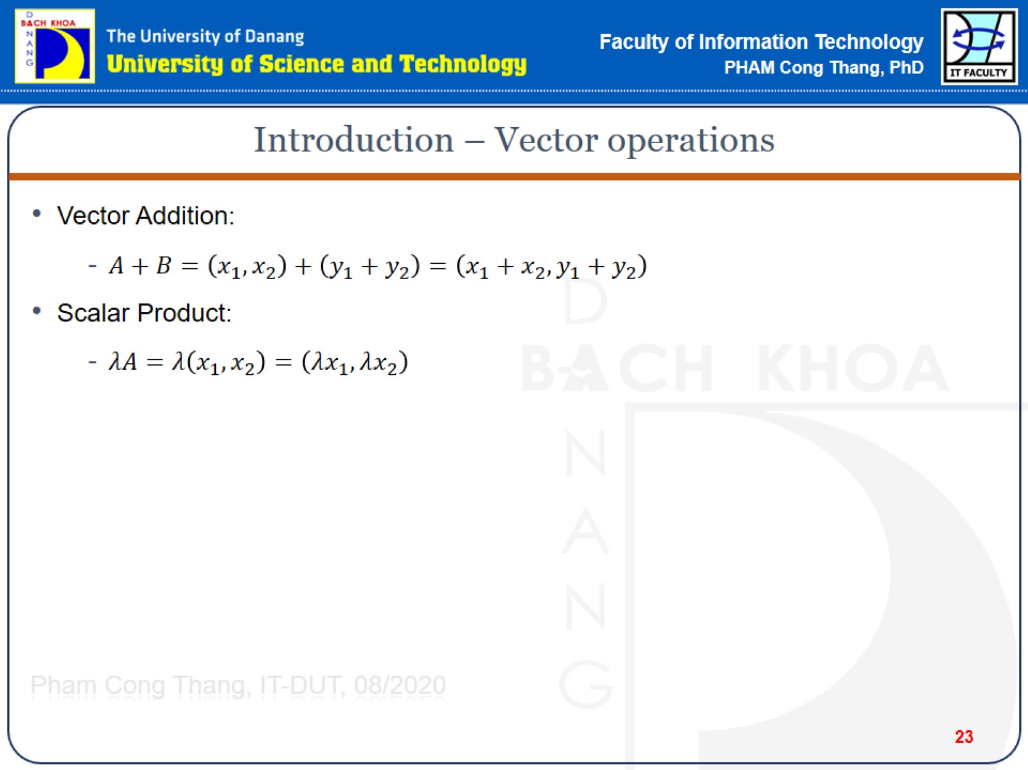
Introduction – Vector operations

Slide 24
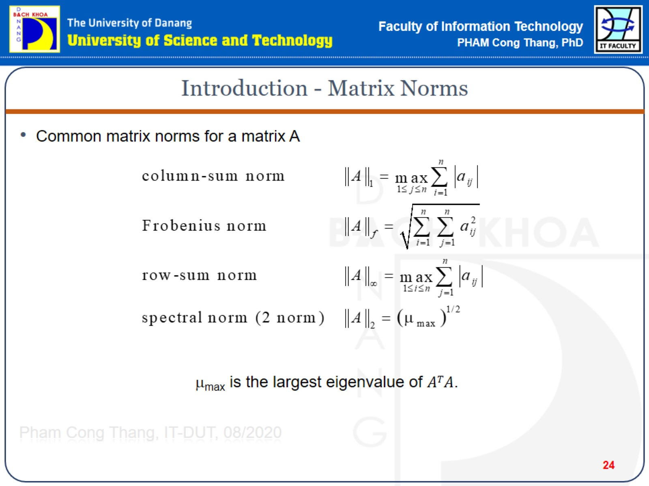
Introduction - Matrix Norms

Slide 25
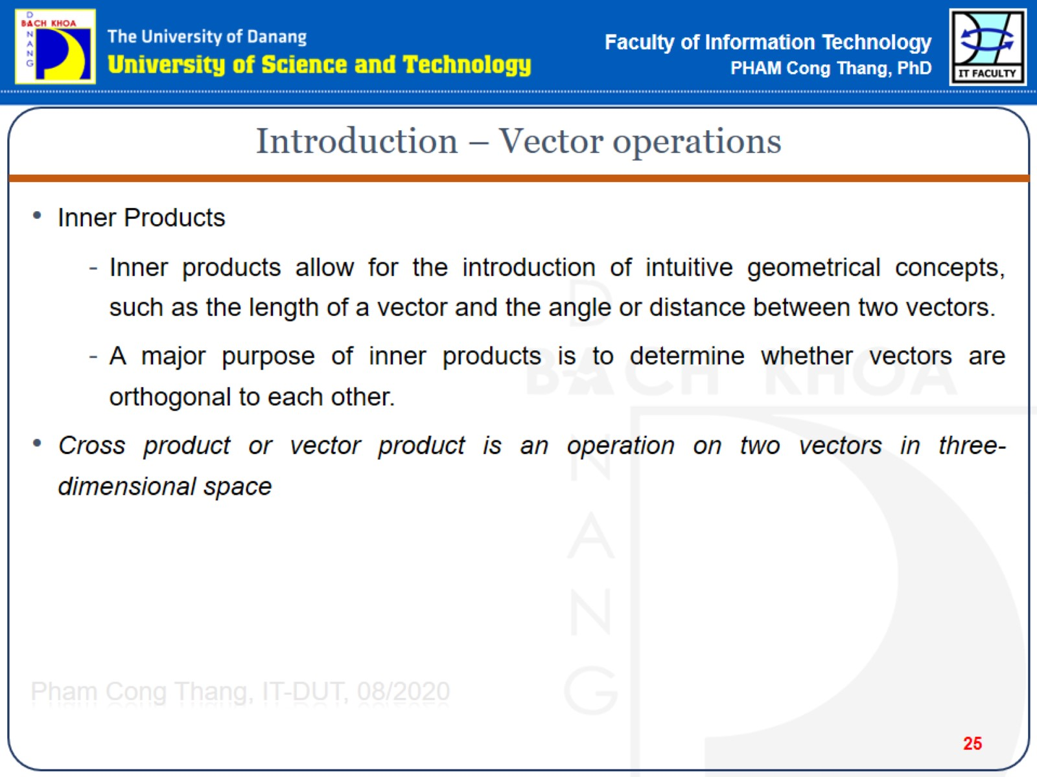
Introduction – Vector operations

Slide 26
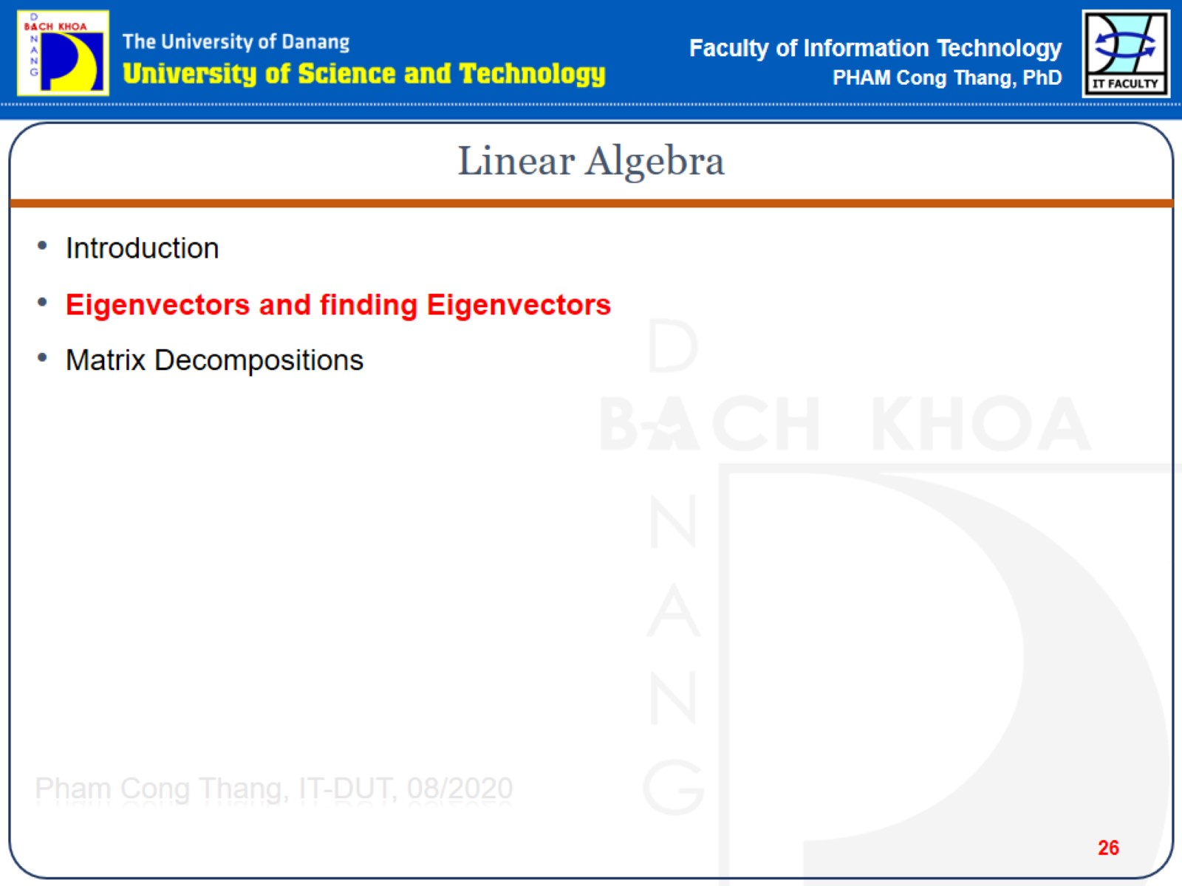
Linear Algebra

Slide 27
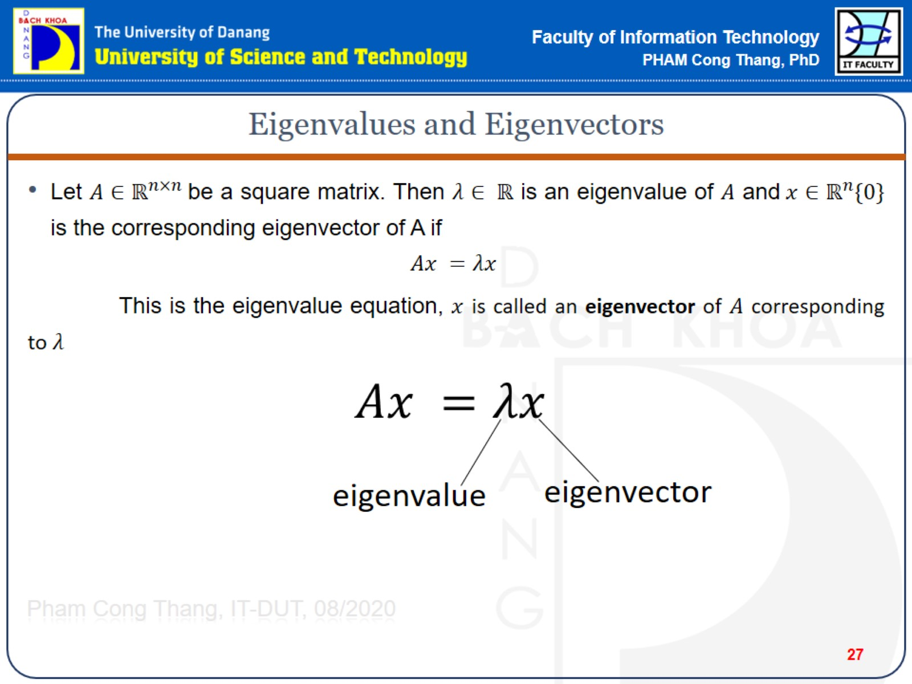
Eigenvalues and Eigenvectors

Slide 28
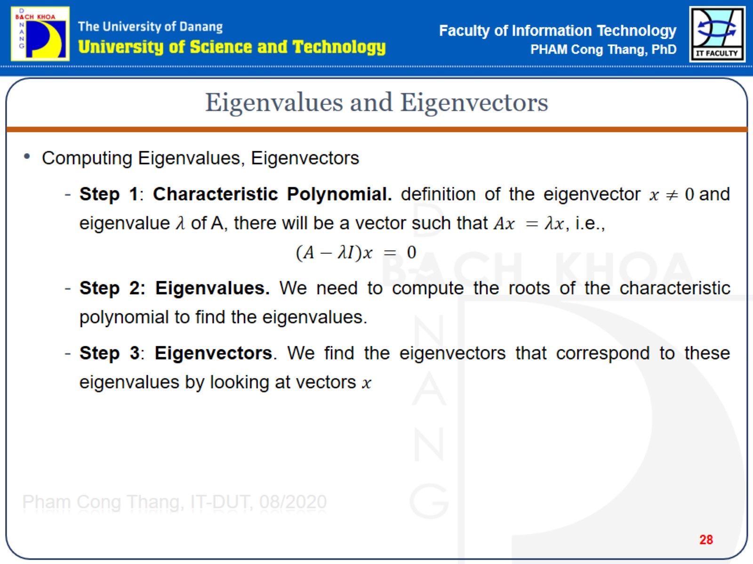
Eigenvalues and Eigenvectors

Slide 29
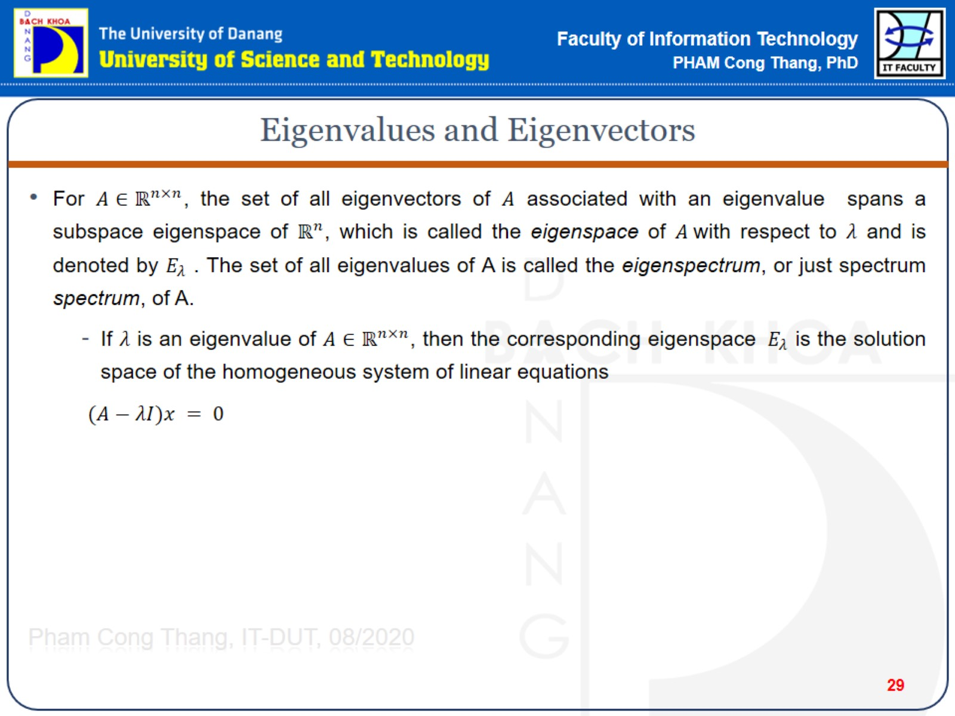
Eigenvalues and Eigenvectors

Slide 30
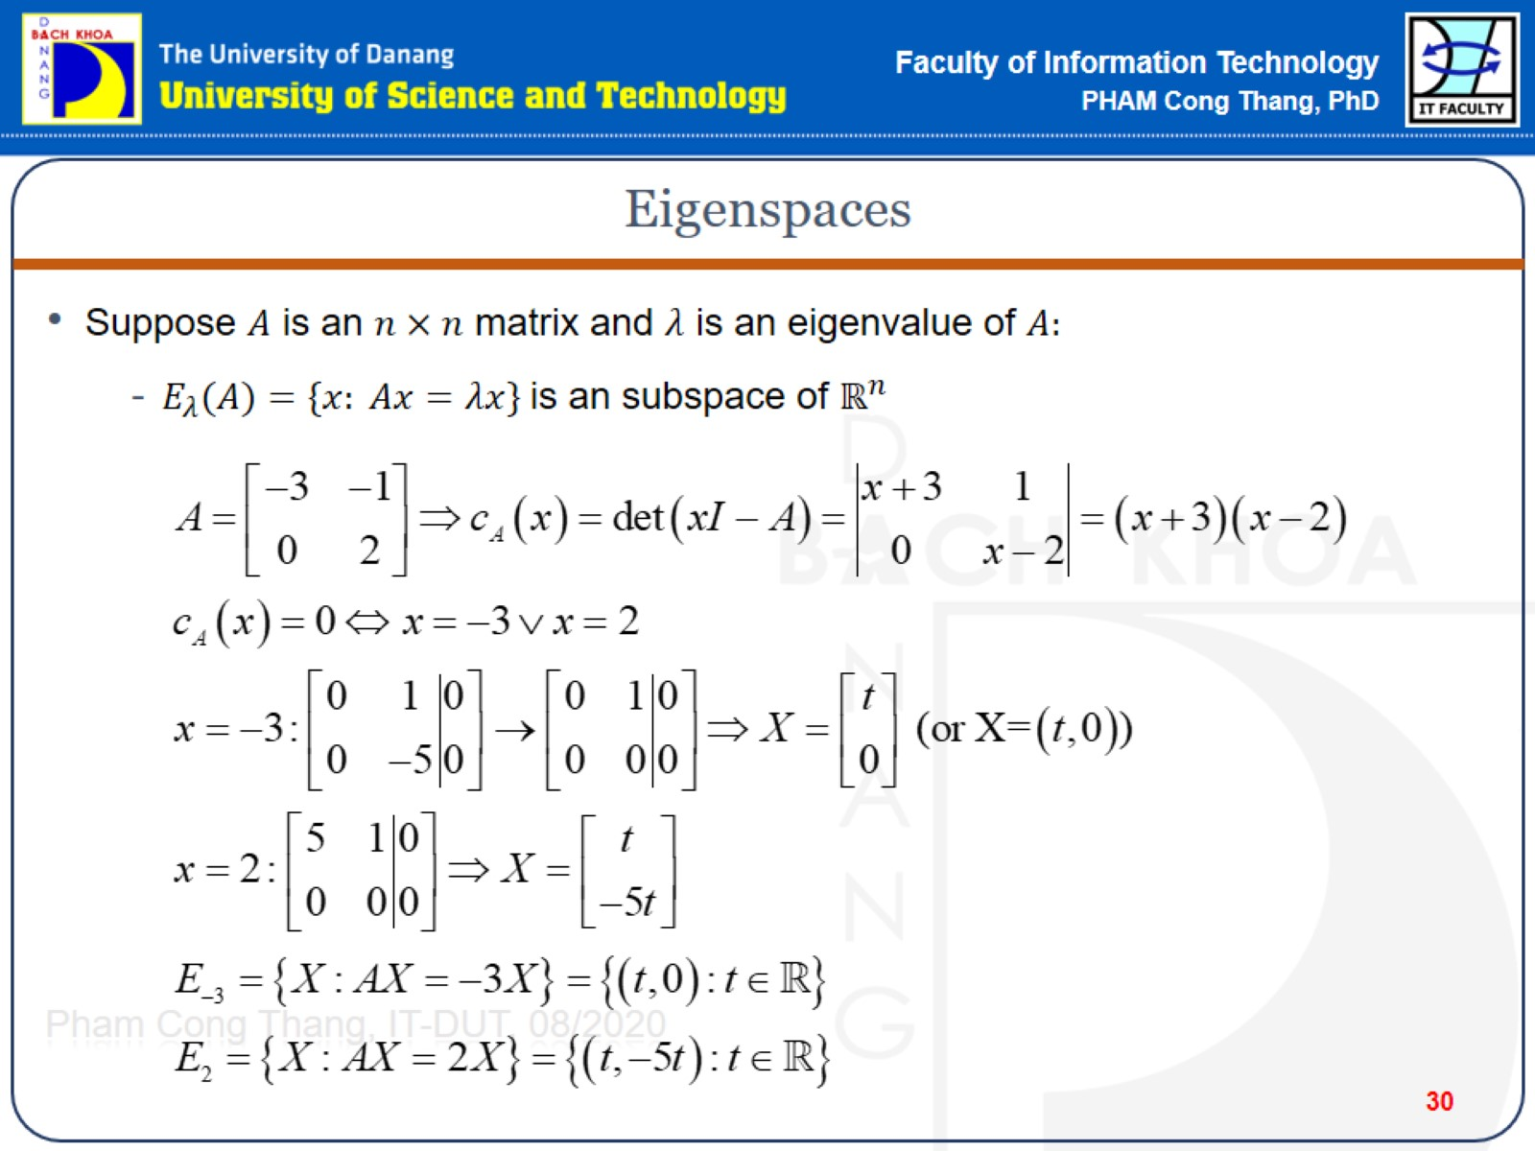
Eigenspaces

Slide 31
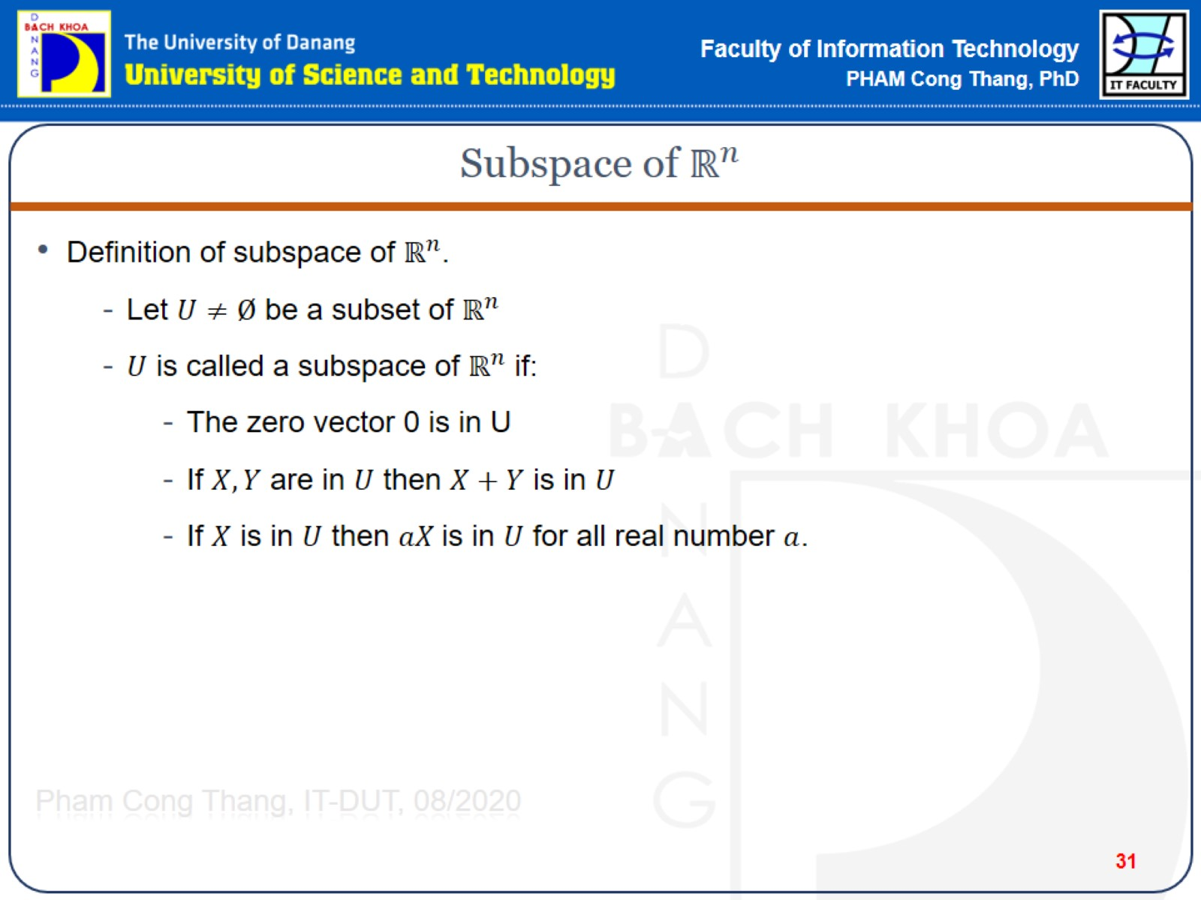

Subspace of $ℝ^{n}$

Slide 32
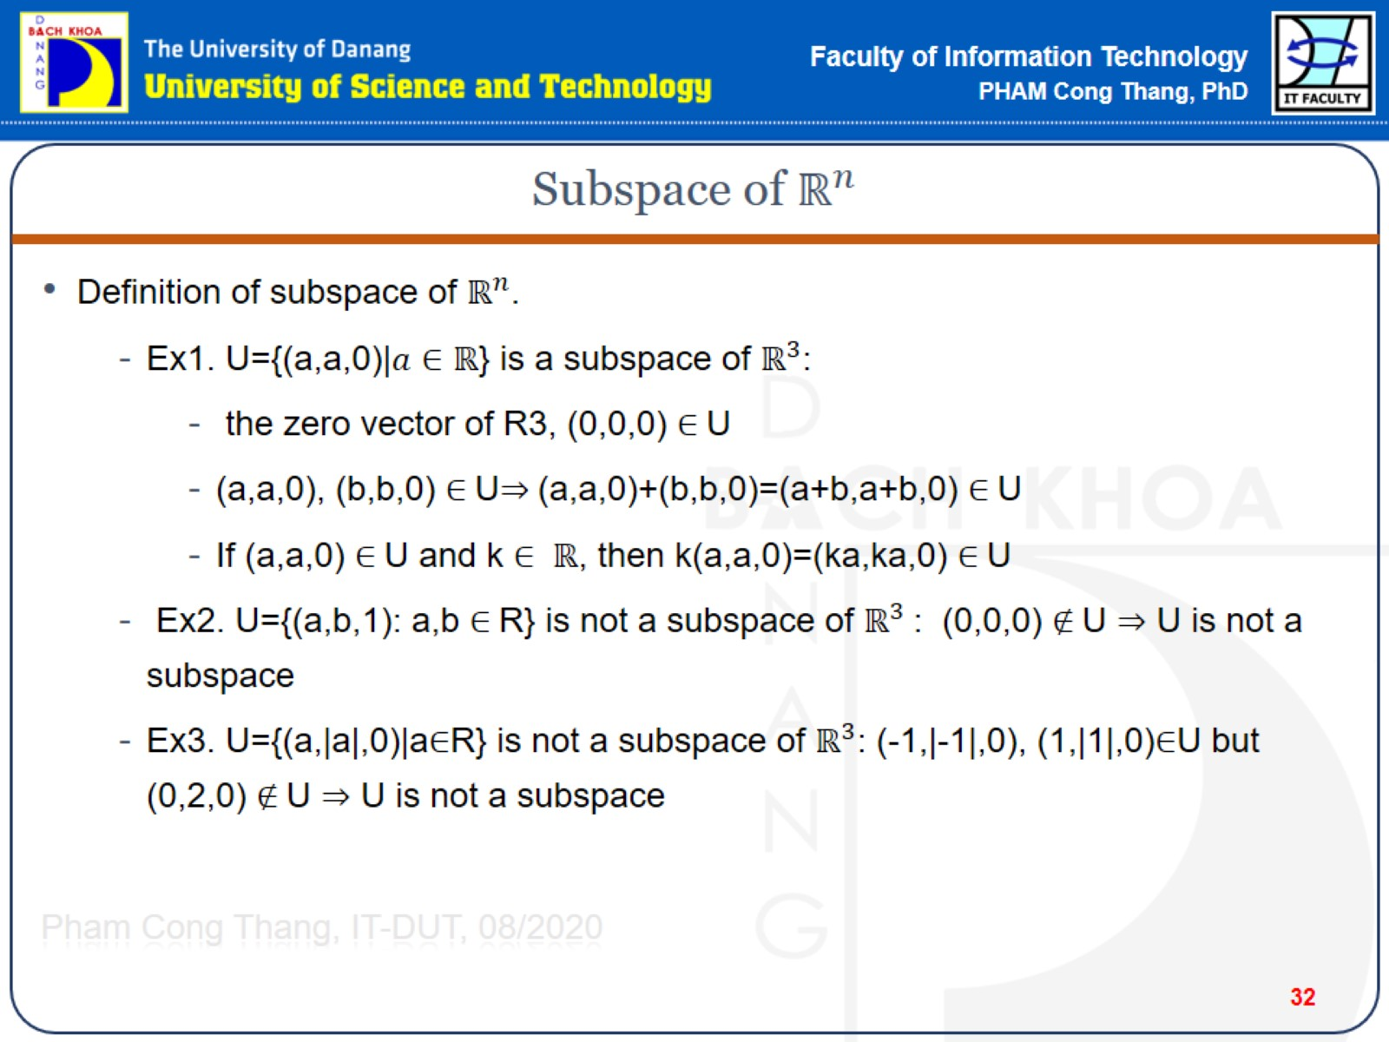
Subspace of $ℝ^{n}$

Slide 33
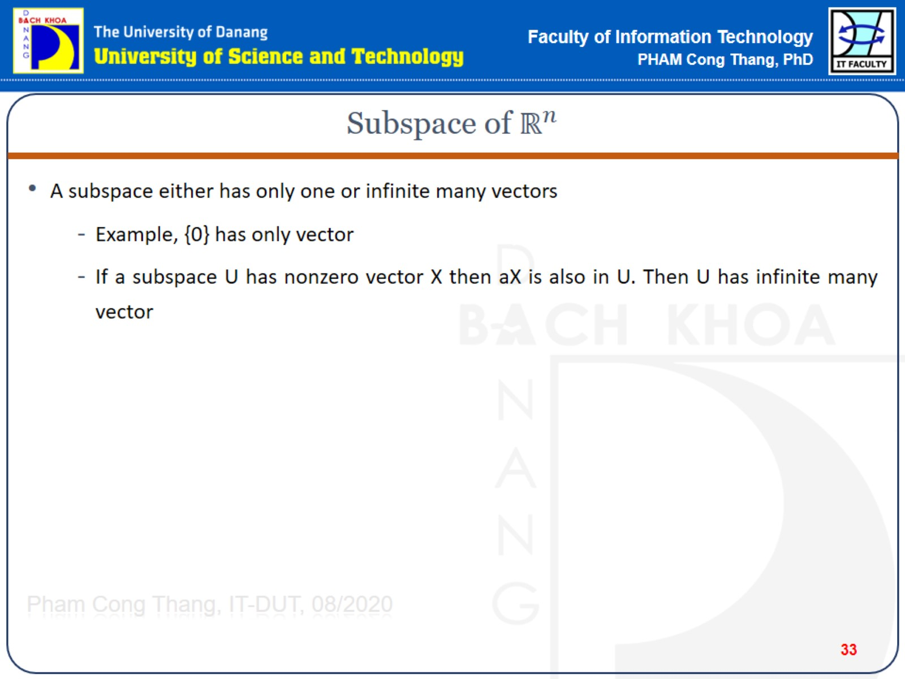
Subspace of $ℝ^{n}$

Slide 34
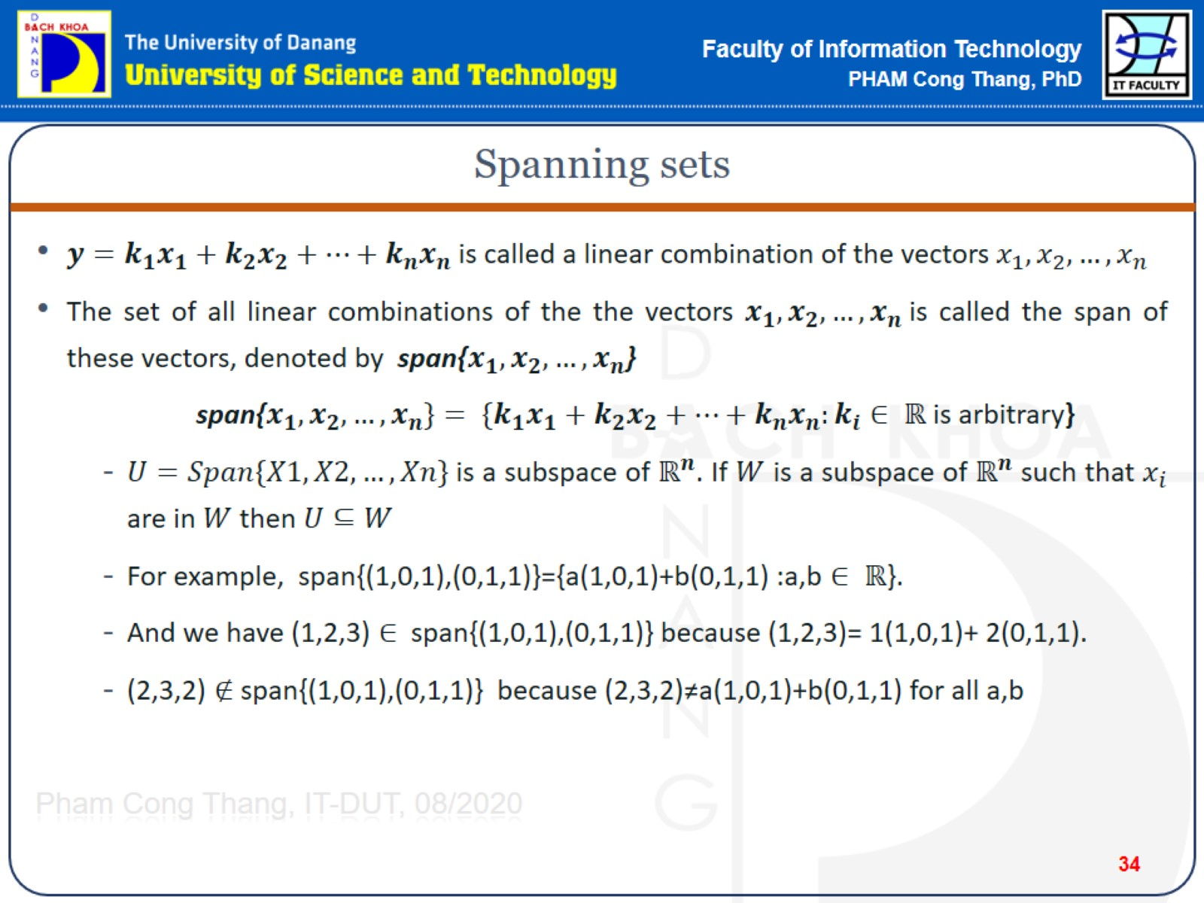
Spanning sets

Slide 35
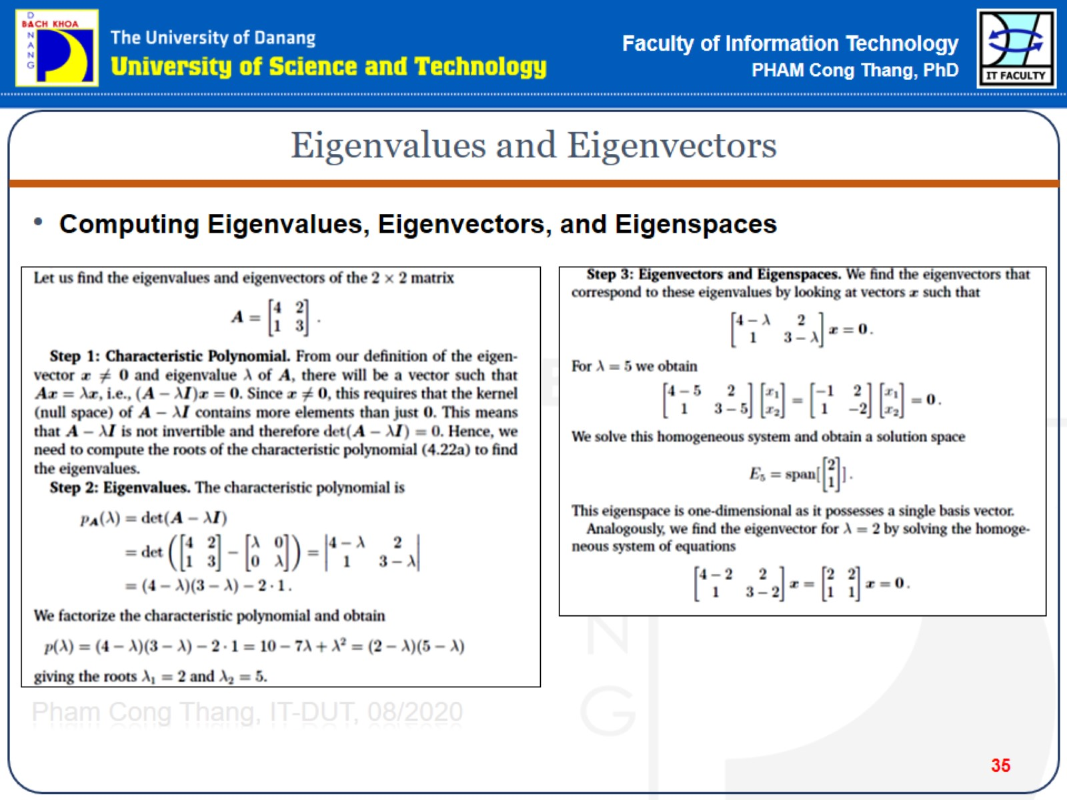
Eigenvalues and Eigenvectors

